Slide 1

Math's 8
Still more differentiation

Slide 2
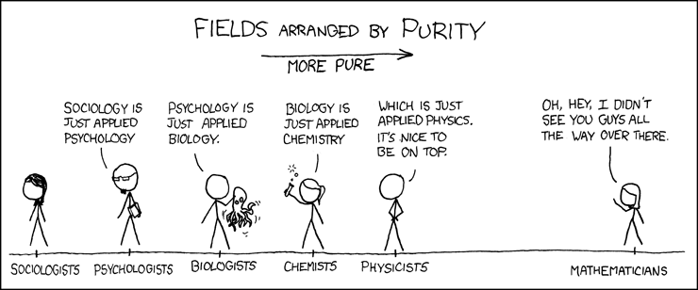
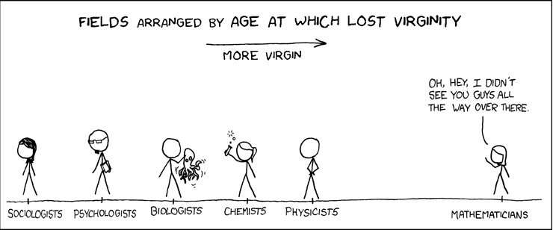
Differentiation … Again

Slide 3
Differentiation … Again
Nearly done with differentiation now!

Slide 4
Differentiation … Again
This time we will go over some applications of the derivative.
The first being determining where a function is increasing and decreasing.

Slide 5
Differentiation … Again
We know that if we look at two points in a function X1 and X2 if X2 is larger than X1 then the function is increasing in between them.
If X2 is smaller than X1 it is decreasing.
This is a basic concept of gradient

Slide 6
Differentiation … Again
We know that if we look at two points in a function X1 and X2 if X2 is larger than X1 then the function is increasing in between them.
If X2 is smaller than X1 it is decreasing.
This is a basic concept of gradient
Derivative is just the gradient!

Slide 7
Differentiation … Again
So using derivatives we can check whether a function is increasing or decreasing at different points.

Slide 8
Differentiation … Again
So using derivatives we can check whether a function is increasing or decreasing at different points.
Lets look at a function :
f(x) = 2x³ + 3x² - 12x + 7

Slide 9
Differentiation … Again
Find the derivative of it first:
f(x) = 2x³ + 3x² - 12x + 7
f’(x) = 6x² + 6x - 12

Slide 10
Differentiation … Again
Find the derivative of it first:
f(x) = 2x³ + 3x² - 12x + 7
f’(x) = 6x² + 6x - 12
To see where the derivative is positive or negative we find the routes.

Slide 11
Differentiation … Again
Find the derivative of it first:
f(x) = 2x³ + 3x² - 12x + 7
f’(x) = 6x² + 6x - 12
f’(x) = 6(x² + x - 2 )

Slide 12
Differentiation … Again
Find the derivative of it first:
f(x) = 2x³ + 3x² - 12x + 7
f’(x) = 6x² + 6x - 12
f’(x) = 6(x - 1) (x + 2 )

Slide 13
Differentiation … Again
Find the derivative of it first:
f’(x) = 6(x - 1) (x + 2 )
So we see from this that there is a root at x = 1 and x = -2.
So these points are when the derivative changes sign.

Slide 14
Differentiation … Again
So lets put values on either side of those values into the equation so see what is happening.
f’(x) = 6x² + 6x - 12
Where x = 2 and x = -3

Slide 15
Differentiation … Again
So lets put values on either side of those values into the equation so see what is happening.
f’(x) = 6x² + 6x - 12
Where x = 2 and x = -3
6*4 + 6*2 -12 = 24

Slide 16
Differentiation … Again
So lets put values on either side of those values into the equation so see what is happening.
f’(x) = 6x² + 6x - 12
Where x = 2 and x = -3
6*4 + 6*2 -12 = 24
6*9 – 6*3 – 12 = 24

Slide 17
Differentiation … Again
So lets put values on either side of those values into the equation so see what is happening.
f’(x) = 6x² + 6x - 12
Where x = 2 and x = -3
6*4 + 6*2 -12 = 24
6*9 – 6*3 – 12 = 24
Hmmmm let’s try a point in the middle x =0

Slide 18
Differentiation … Again
So lets put values on either side of those values into the equation so see what is happening.
f’(x) = 6x² + 6x - 12
Where x = 2 and x = -3
6*4 + 6*2 -12 = 24
6*9 – 6*3 – 12 = 24
6*0 – 6*0 -12 = -12

Slide 19
Differentiation … Again
So lets put values on either side of those values into the equation so see what is happening.
f’(x) = 6x² + 6x - 12
Where x = 2 and x = -3
6*4 + 6*2 -12 = 24
6*9 – 6*3 – 12 = 24
6*0 – 6*0 -12 = -12
So where there is a positive gradient the function is increasing and negative it is decreasing.

Slide 20
Differentiation … Again
So with our function f(x) = 2x³ + 3x² - 12x + 7 we know that:
The function is flat at -2 and 1.
Increasing at -3 and 2
And decreasing at 0

Slide 21
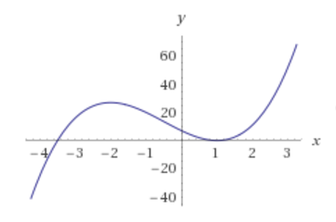
Differentiation … Again
So with our function f(x) = 2x³ + 3x² - 12x + 7 we know that:
The function is flat at -2 and 1.
Increasing at -3 and 2
And decreasing at 0

Slide 22
Differentiation … Again
So with our function f(x) = 2x³ + 3x² - 12x + 7 we know that:
The function is flat at -2 and 1.
Increasing at -3 and 2
And decreasing at 0
Yep Looks about right!

Slide 23
Differentiation … Again
We’ve learned how to work out if a function is increasing or decreasing but what if we want to learn more about it’s shape?
Well we can learn about a functions concavity from it’s second order derivative.
Concavity is how a line curves in a parabola. It can be up or down.

Slide 24
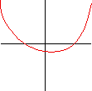
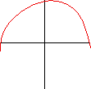
Differentiation … Again
Concavity is how a line curves in a parabola. It can be up or down.
concave up concave down
Despite the fact the top is pointing the wrong way!

Slide 25
Differentiation … Again
How does concavity work?
Well if we know that the derivative of the derivative is the gradient of the gradient i.e. how the gradient is changing over time.
So if the gradient of the gradient is positive then the function is concave up (called convex), if it is negative it is concave down.

Slide 26
Differentiation … Again
Concave up is when the tangent line of the differential is below the function line, concave up it is above.

Slide 27
Differentiation … Again
Concave up is when the tangent line of the differential is below the function line, concave up it is above.
When the second derivative changes sign from positive to negative this is called an inflection point

Slide 28
Differentiation … Again
Concave up is when the tangent line of the differential is below the function line, concave up it is above.
When the second derivative changes sign from positive to negative this is called an inflection point

Slide 29
Differentiation … Again
So if we want to find out whether a slope is positive or negative and find the inflection points we did this in the last problem.
This time we just do it with the second order derivative.

Slide 30
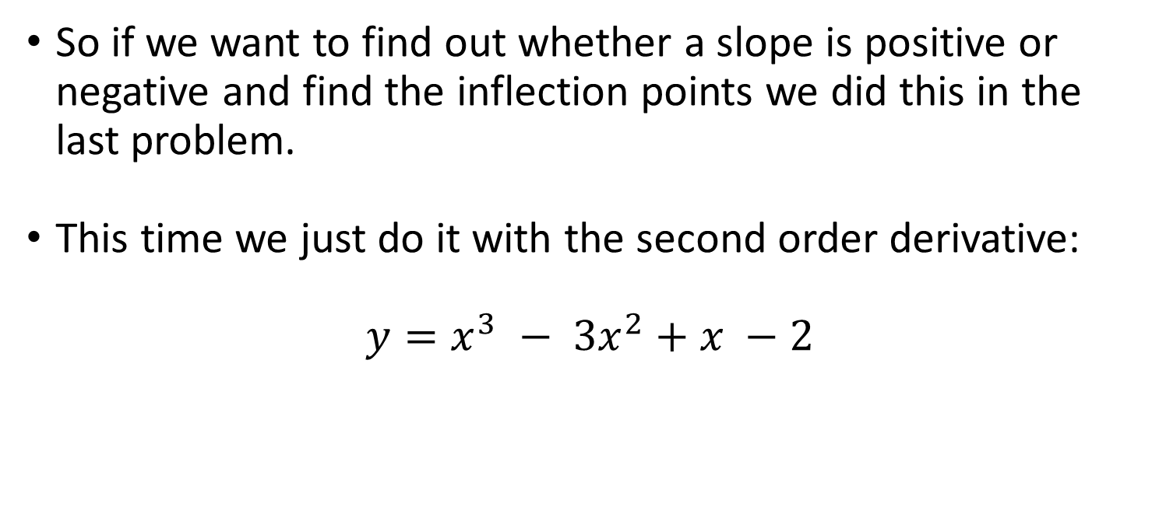
Differentiation … Again
So if we want to find out whether a slope is positive or negative and find the inflection points we did this in the last problem.
This time we just do it with the second order derivative:
$y=x^{3} − {3x}^{2}+x −2$

Slide 31
Differentiation … Again
So if we want to find out whether a slope is positive or negative and find the inflection points we did this in the last problem.
This time we just do it with the second order derivative:
$y=x^{3} − {3x}^{2}+x −2$

Slide 32

Differentiation … Again
This time we just do it with the second order derivative:
$y=x^{3} − {3x}^{2}+x −2$
$$y′={3x}^{2} −6x+1$$

Slide 33

Differentiation … Again
This time we just do it with the second order derivative:
$y=x^{3} − {3x}^{2}+x −2$
$$y′={3x}^{2} −6x+1$$
$$y′′=6x −6$$

Slide 34

Differentiation … Again
This time we just do it with the second order derivative:
$y=x^{3} − {3x}^{2}+x −2$
$$y′={3x}^{2} −6x+1$$
$$y′′=6(x −1)$$

Slide 35
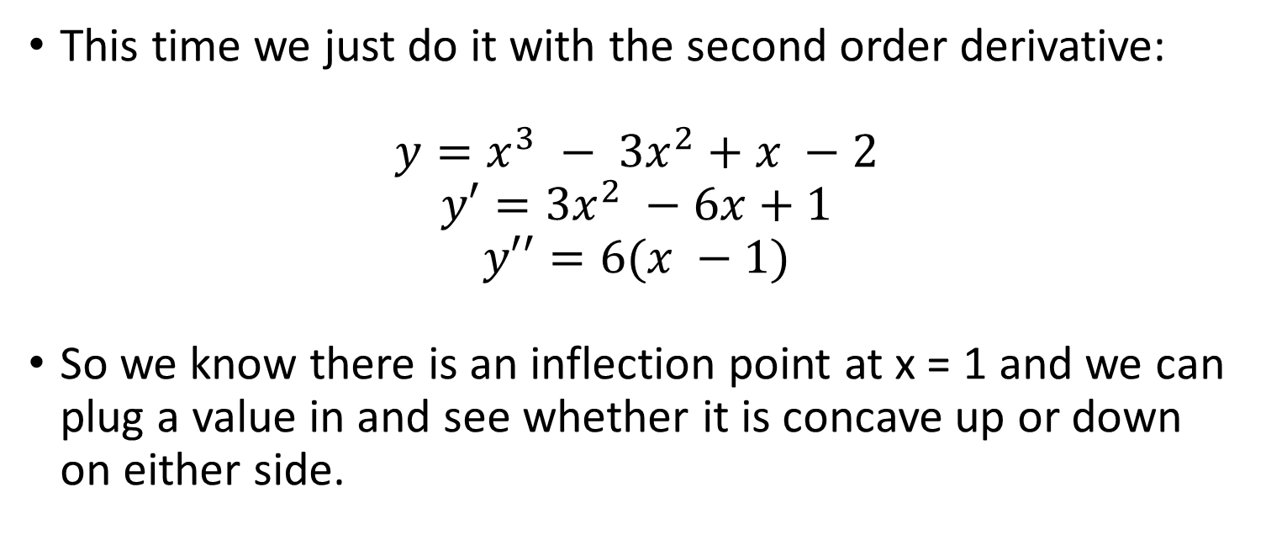
Differentiation … Again
This time we just do it with the second order derivative:
$y=x^{3} − {3x}^{2}+x −2$
$$y′={3x}^{2} −6x+1$$
$$y′′=6(x −1)$$
So we know there is an inflection point at x = 1 and we can plug a value in and see whether it is concave up or down on either side.

Slide 36

Differentiation … Again
This time we just do it with the second order derivative:
$y=x^{3} − {3x}^{2}+x −2$
$$y′={3x}^{2} −6x+1$$
$$y′′=6(x −1)$$
6(2-1) = 6

Slide 37
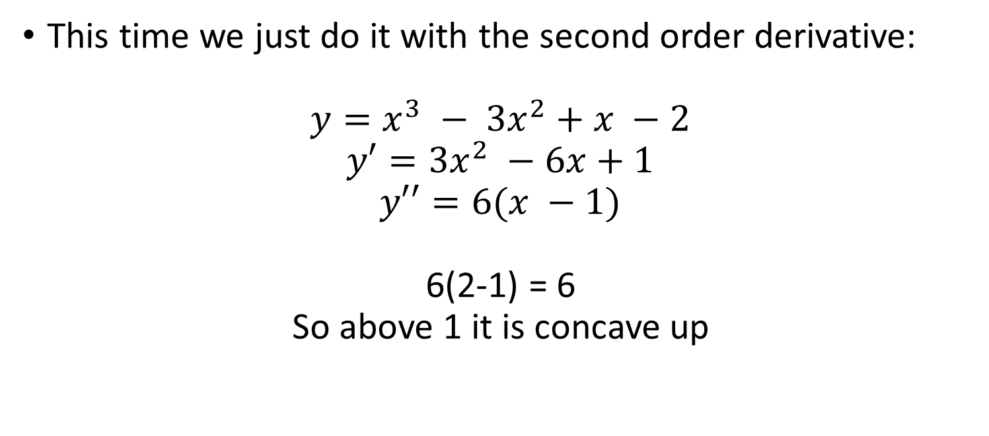
Differentiation … Again
This time we just do it with the second order derivative:
$y=x^{3} − {3x}^{2}+x −2$
$$y′={3x}^{2} −6x+1$$
$$y′′=6(x −1)$$
6(2-1) = 6
So above 1 it is concave up

Slide 38

Differentiation … Again
This time we just do it with the second order derivative:
$y=x^{3} − {3x}^{2}+x −2$
$$y′={3x}^{2} −6x+1$$
$$y′′=6(x −1)$$
6(0 – 1) = -6

Slide 39
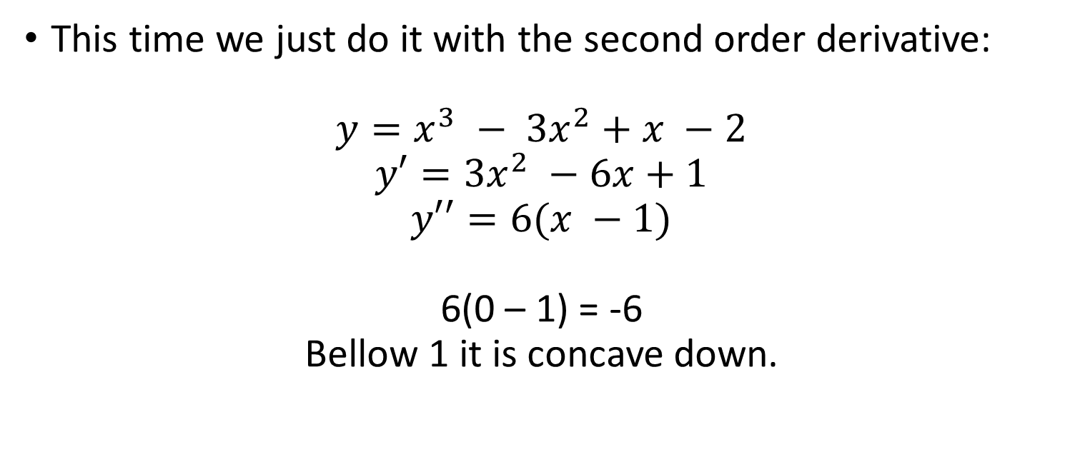
Differentiation … Again
This time we just do it with the second order derivative:
$y=x^{3} − {3x}^{2}+x −2$
$$y′={3x}^{2} −6x+1$$
$$y′′=6(x −1)$$
6(0 – 1) = -6
Bellow 1 it is concave down.

Slide 40
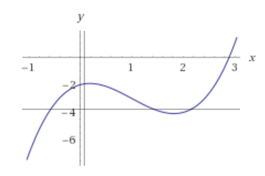
Differentiation … Again
This time we just do it with the second order derivative:
$y=x^{3} − {3x}^{2}+x −2$
$$y′={3x}^{2} −6x+1$$
$$y′′=6(x −1)$$
6(0 – 1) = -6
Bellow 1 it is concave down.

Slide 41
Differentiation … Again
There is a final point where we can use concavity to work out where there is a local maximum or minimum.
If we remember that f’(x) is the gradient if f’(x) = 0 then there is no change between the two points. i.e. the line is flat at this point.
This could mean that it is either a maximum or a minimum of a curve (or a totally flat line).

Slide 42
Differentiation … Again
Using concavity and the second derivative we can then determine if this flat gradient point is a maximum or a minimum.
If the second derivative is concave up when the first derivative is 0 then it is a minimum and if it concave down then it is a maximum.

Slide 43

Differentiation … Again
Returning to our previous function:
$y=x^{3} − {3x}^{2}+x −2$
If
$$y′={3x}^{2} −6x+1$$
Where y = 0

Slide 44
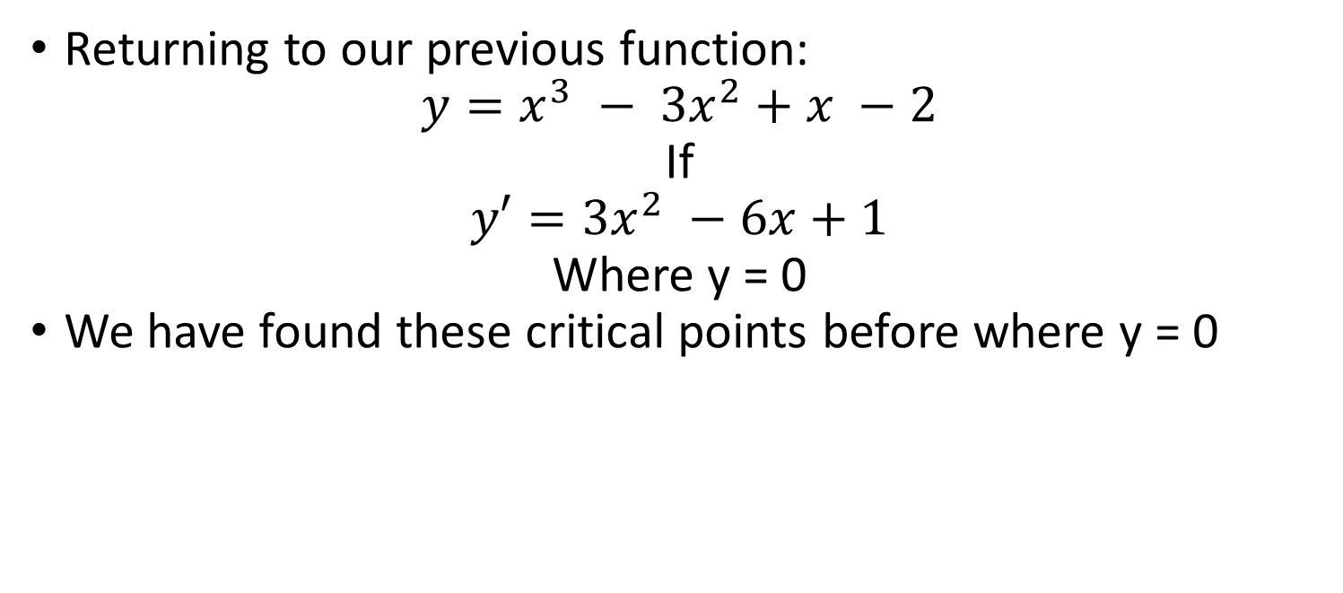
Differentiation … Again
Returning to our previous function:
$y=x^{3} − {3x}^{2}+x −2$
If
$$y′={3x}^{2} −6x+1$$
Where y = 0
We have found these critical points before where y = 0

Slide 45
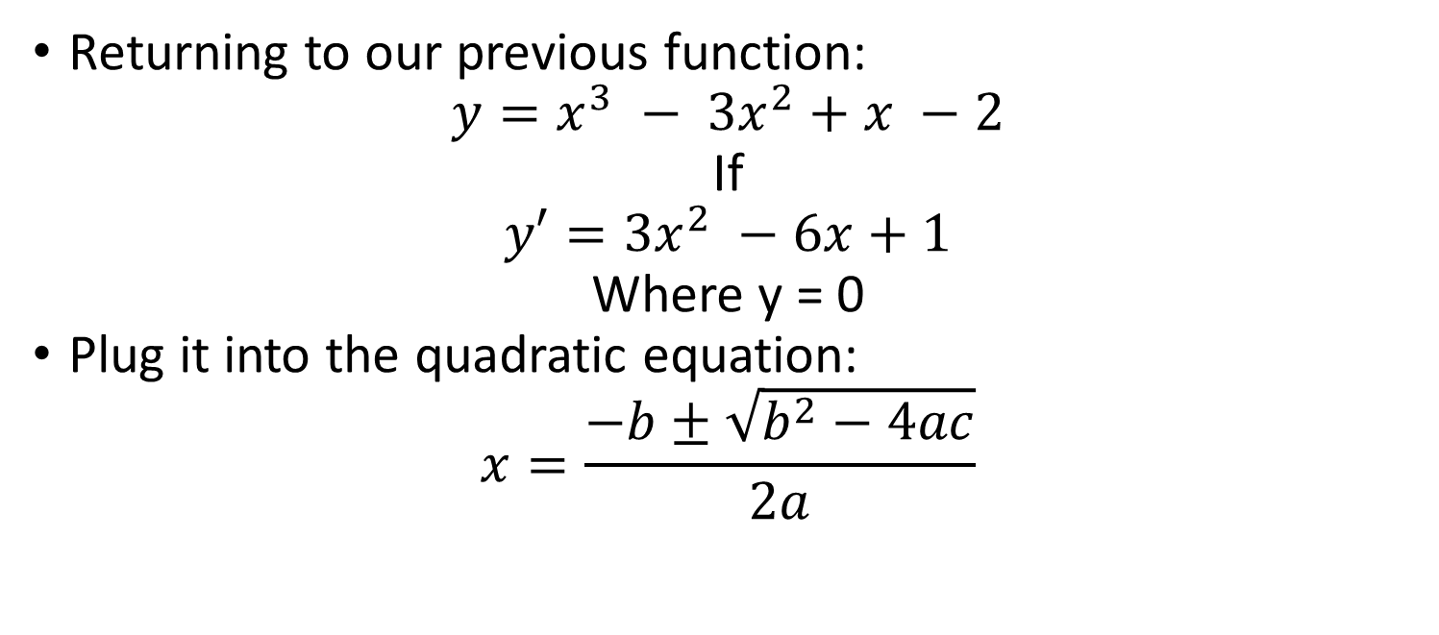
Differentiation … Again
Returning to our previous function:
$y=x^{3} − {3x}^{2}+x −2$
If
$$y′={3x}^{2} −6x+1$$
Where y = 0
Plug it into the quadratic equation:
$$x=\frac{−b±\sqrt{b^{2}−4ac}}{2a}$$

Slide 46
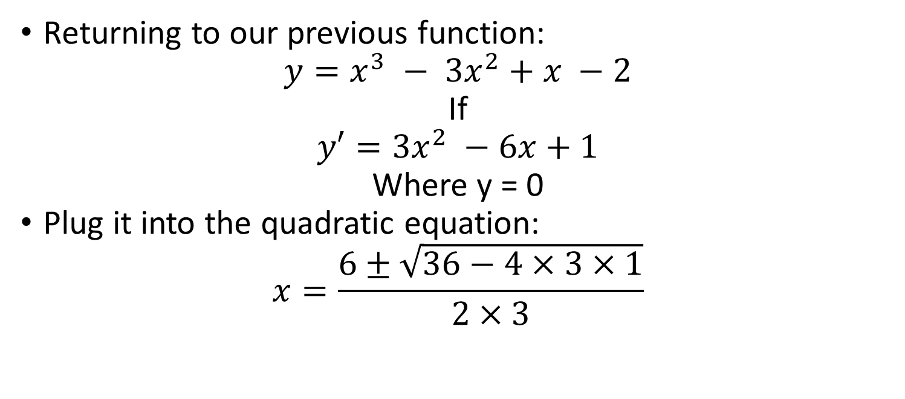
Differentiation … Again
Returning to our previous function:
$y=x^{3} − {3x}^{2}+x −2$
If
$$y′={3x}^{2} −6x+1$$
Where y = 0
Plug it into the quadratic equation:
$$x=\frac{6±\sqrt{36−4×3×1}}{2×3}$$

Slide 47
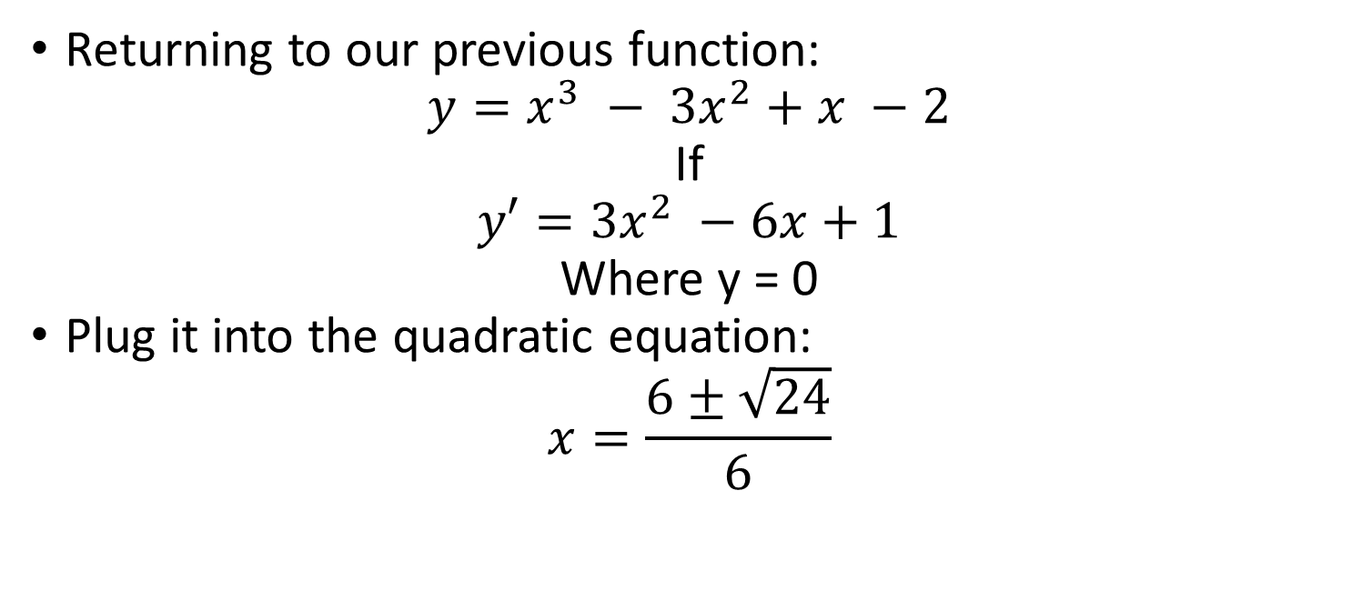
Differentiation … Again
Returning to our previous function:
$y=x^{3} − {3x}^{2}+x −2$
If
$$y′={3x}^{2} −6x+1$$
Where y = 0
Plug it into the quadratic equation:
$$x=\frac{6±\sqrt{24}}{6}$$

Slide 48
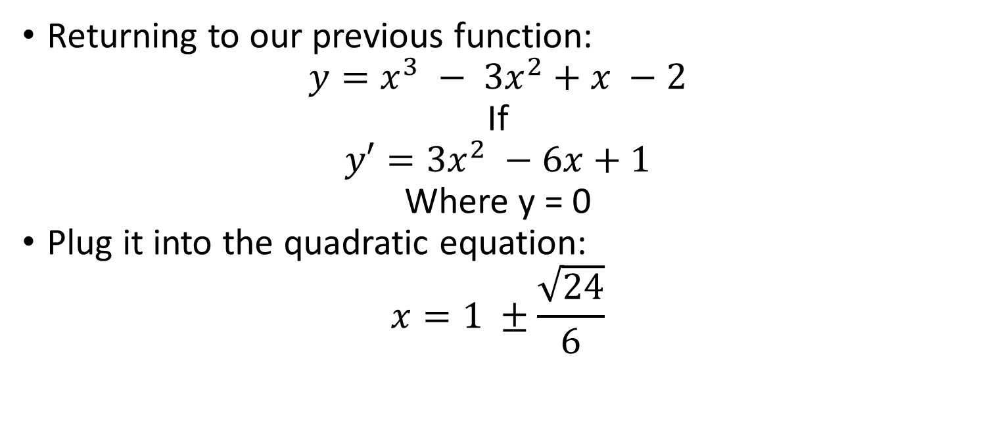
Differentiation … Again
Returning to our previous function:
$y=x^{3} − {3x}^{2}+x −2$
If
$$y′={3x}^{2} −6x+1$$
Where y = 0
Plug it into the quadratic equation:
$$x=1 ±\frac{\sqrt{24}}{6}$$

Slide 49
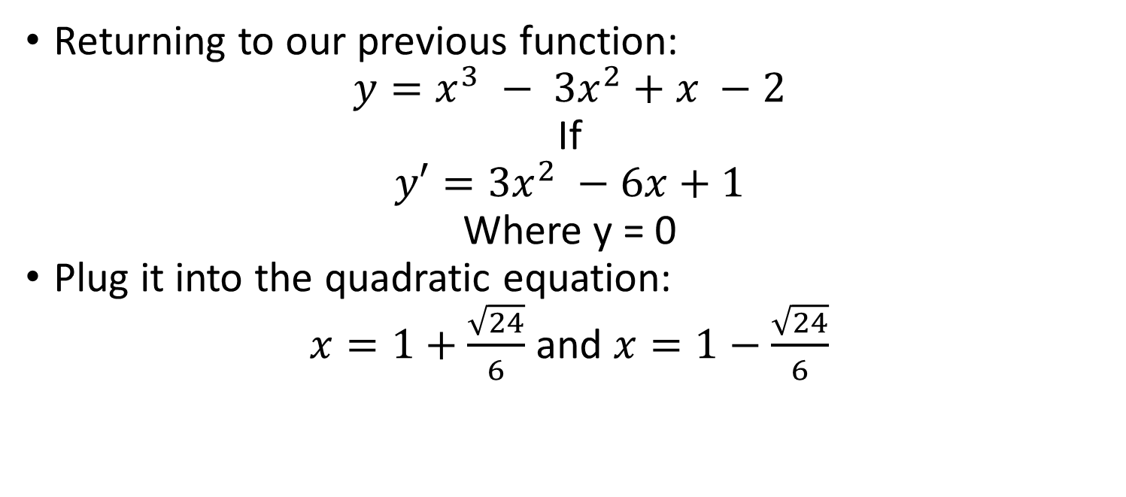
Differentiation … Again
Returning to our previous function:
$y=x^{3} − {3x}^{2}+x −2$
If
$$y′={3x}^{2} −6x+1$$
Where y = 0
Plug it into the quadratic equation:
$x=1+\frac{\sqrt{24}}{6}$ and $x=1−\frac{\sqrt{24}}{6}$

Slide 50
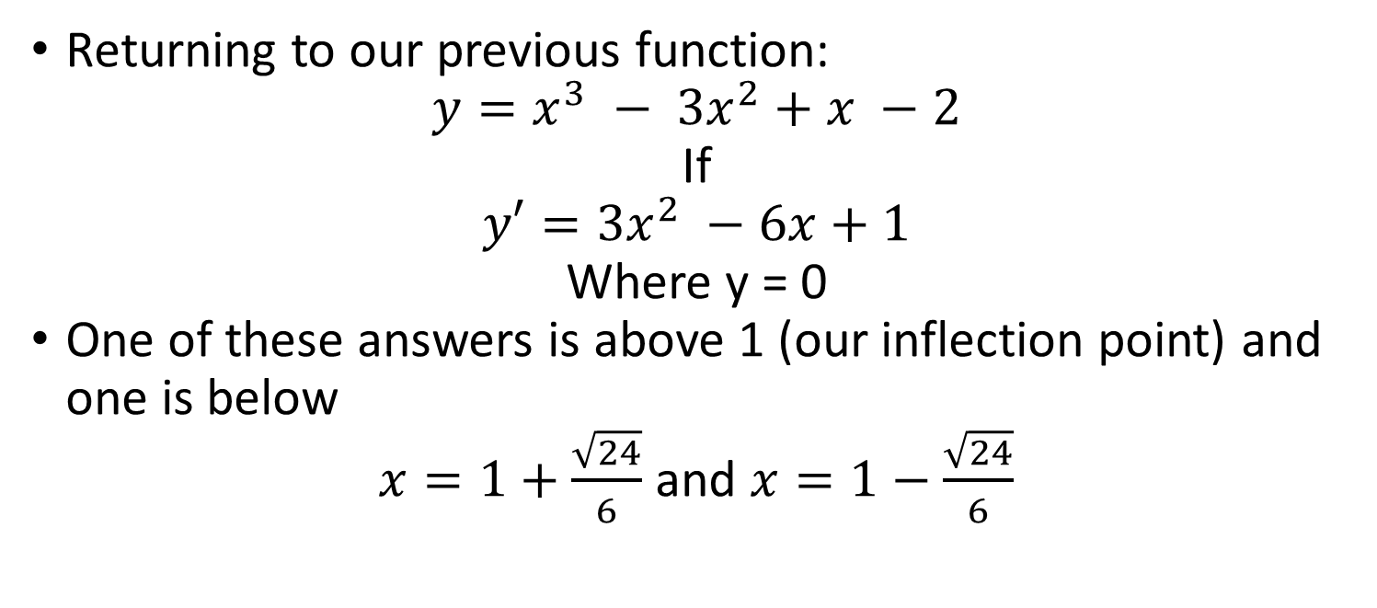
Differentiation … Again
Returning to our previous function:
$y=x^{3} − {3x}^{2}+x −2$
If
$$y′={3x}^{2} −6x+1$$
Where y = 0
One of these answers is above 1 (our inflection point) and one is below
$x=1+\frac{\sqrt{24}}{6}$ and $x=1−\frac{\sqrt{24}}{6}$

Slide 51
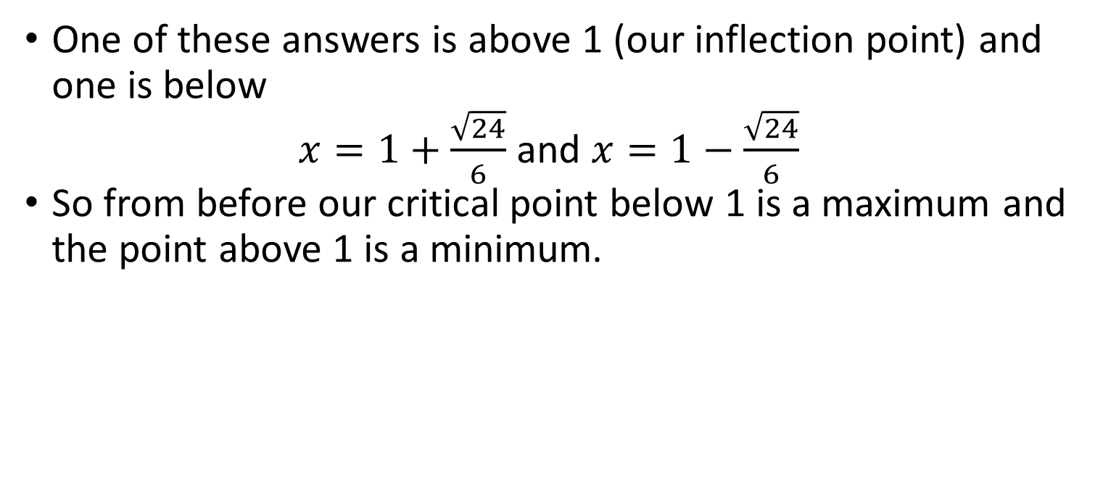
Differentiation … Again
One of these answers is above 1 (our inflection point) and one is below
$x=1+\frac{\sqrt{24}}{6}$ and $x=1−\frac{\sqrt{24}}{6}$
So from before our critical point below 1 is a maximum and the point above 1 is a minimum.

Slide 52
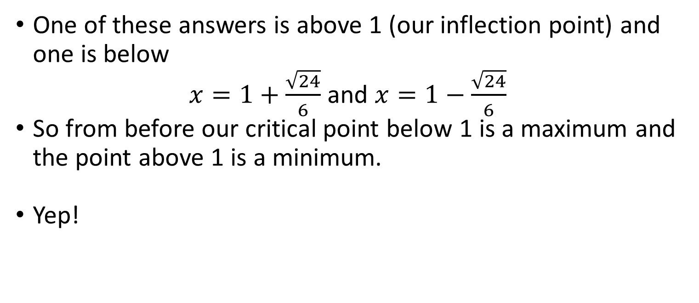
Differentiation … Again
One of these answers is above 1 (our inflection point) and one is below
$x=1+\frac{\sqrt{24}}{6}$ and $x=1−\frac{\sqrt{24}}{6}$
So from before our critical point below 1 is a maximum and the point above 1 is a minimum.
Yep!

Slide 53
Differentiation … Again
Our final applied differential is the asymptote.
An asymptote is a line that a curve approaches, but never touches, as it tends towards infinity.
Like a stalker or you trying to attain your hopes and dreams.

Slide 54
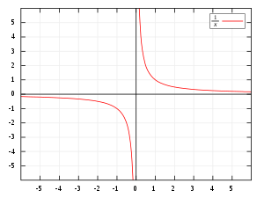
Differentiation … Again
An asymptote is a line that a curve approaches, but never touches, as it tends towards infinity.
As the curve gets infinitely closer
to the asymptote the difference
between them gets infinitely small
but does exist.

Slide 55
Differentiation … Again
There are three different kind of asymptotes: Horizontal, vertical and oblique.
Horizontal

Slide 56
Differentiation … Again
There are three different kind of asymptotes: Horizontal, vertical and oblique.
Vertical

Slide 57
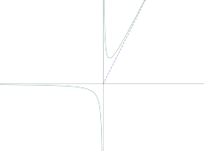
Differentiation … Again
There are three different kind of asymptotes: Horizontal, vertical and oblique.
Oblique

Slide 58
Differentiation … Again
The asymptote is the final part of understanding curves and their properties.
Being able to find the asymptote is actually pretty much the same as being able to find the limit where y of x approaches infinity.

Slide 59

Differentiation … Again
If we look at the function f(x) = $\frac{1}{x}$
We can see that y approaches ∞
as x = 0 so
$\lim_{x →0} \frac{1}{x}$

Slide 60

Differentiation … Again
$\lim_{x →0} \frac{1}{x}$
But a vertical line of x = 0 is the
vertical asymptote of function.

Slide 61

Differentiation … Again
$\lim_{x →0} \frac{1}{x}$
But a vertical line of x = 0 is the
vertical asymptote of function.
y also trends towards 0 as x
approaches infinity.

Slide 62

Differentiation … Again
$\lim_{y →0} \frac{1}{x}$
y also trends towards 0 as x
approaches infinity.
So the function line y = 0 is a
horizontal asymptote of the
function

